Slide 1
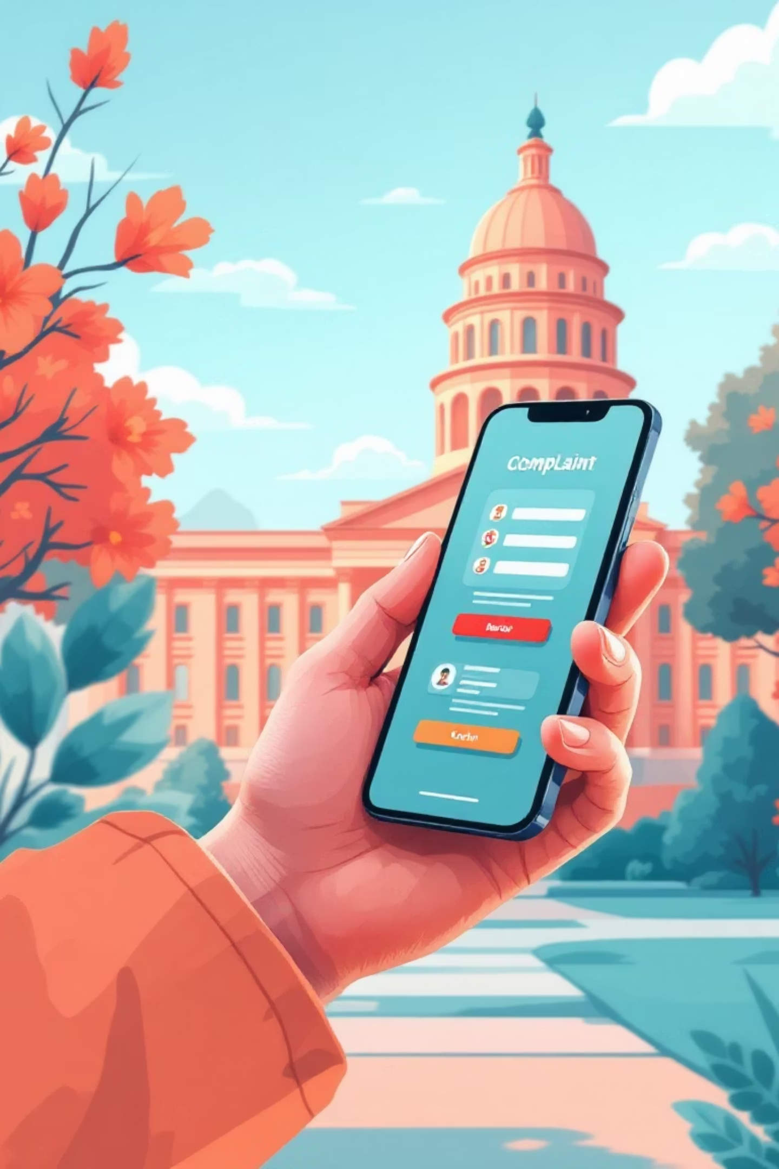

Big 5 Category
Public Service Architecture Revamp
List of Teammates
Samuel
Debbie
Tonny
Team Location
Freetown, Sierra Leone
Ombudsman Digital Complaint Portal
A national platform for transparent, accessible, and trackable reporting of public sector misconduct.
Built for Accountability. Built for Citizens.

Slide 2

The Problem: An Obsolete System
Slow & Inaccessible
Lack of Transparency
Current complaint processes are paper-based, slow, and often inaccessible, particularly for citizens in rural areas who face costly travel just to file a report.
There is no reliable way for citizens to track the progress of their complaints or verify if any action was taken, leading to frustration and distrust.
Data Silos
Ombudsman offices struggle to analyze patterns of corruption due to scattered or missing data, hindering systemic improvements and targeted interventions.
Result: Zero transparency, zero accountability.

Slide 3


The Solution: A Digital Transformation
A national digital portal that revolutionizes how citizens interact with public oversight.
For Citizens
For Government
Online Submission
Powerful Dashboard
Submit complaints conveniently online or via mobile devices from anywhere.
Gain access to a comprehensive dashboard to view and efficiently manage all cases.
Real-time Updates
Identify Hotspots
Receive real-time SMS notifications on the status of their complaint.
Quickly identify geographical hotspots of misconduct and areas requiring immediate attention.
Secure Tracking
Track complaint status with a unique, secure reference ID for full transparency.
Pattern Detection
Detect recurring patterns by ministry or official, enabling data-driven policy changes.

Slide 4




Key Features: Empowering Both Sides
For Citizens: Enhanced Accessibility & Control
For Government: Data-Driven Oversight
Simple Online Form
Admin Dashboard
An intuitive, easy-to-use interface for submitting complaints.
A centralized platform for comprehensive case management.
SMS Updates
Case Status Updates
Automated text messages keeping citizens informed at every step.
Efficient tools for updating and managing the lifecycle of each case.
Tracking Portal
Real-time Analytics
A dedicated online portal to monitor the real-time status of their complaint.
Insights into trends, affected ministries, and officials for strategic action.
Optional Anonymity
Export & Audit Trail
The choice to remain anonymous, ensuring safety and encouraging reporting.
Robust data export capabilities and a complete audit trail for accountability.

Slide 5
Demo Flow: A Seamless Process
Submission & ID
1
User submits a complaint, receiving a unique Reference ID.
2
SMS Confirmation
An immediate SMS confirms successful submission.
Online Tracking
3
User tracks their case progress via the portal.
4
Admin Review & Update
Admin reviews, changes status, triggering next SMS alert.
Dashboard Insights
5
Dashboard reveals affected ministries, reported officials, and complaint distribution.
This streamlined process ensures clarity and accountability from start to finish.

Slide 6





Impact & Next Steps: Building a Stronger Future
Tangible Impact
Future Enhancements
1
Multi-language & Offline Support
Faster Resolution
Accelerated complaint processing for citizens.
Photo/Video Evidence Uploads
2
3
Verification via National ID
Enhanced Transparency
Unprecedented clarity in public sector oversight.
4
AI-Powered Case Categorization
Data-Driven Anti-Corruption
Evidence-based strategies to combat misconduct.
Reduced Burden
Greater efficiency for Ombudsman staff.

